Slide 1
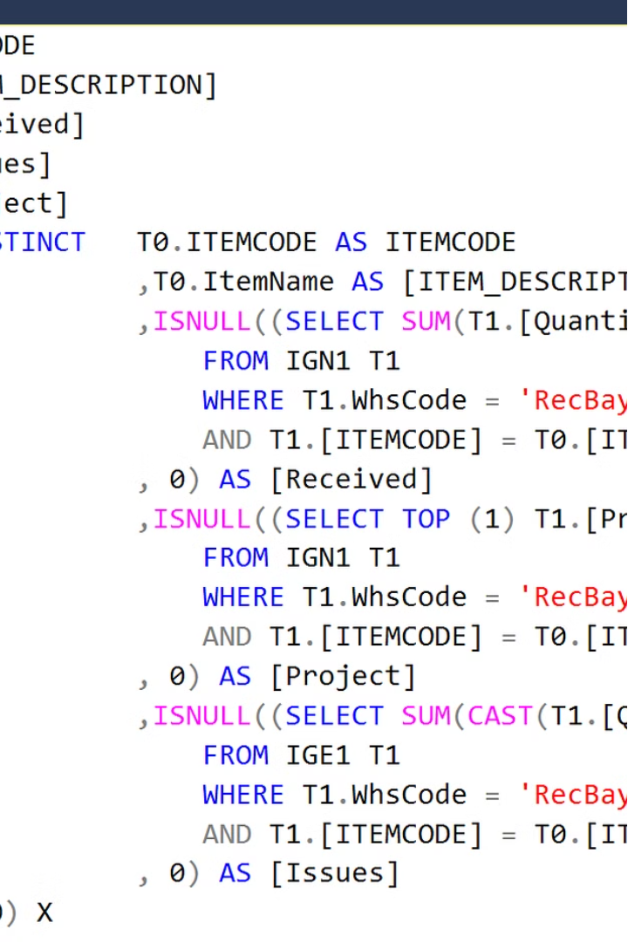

Introduction to SQL
SQL, or Structured Query Language, is the foundation for managing and manipulating relational databases. It allows users to create, modify and query data with efficiency and precision, making it an essential tool for data-driven decision making.
Presented By: Rushali Setia

Slide 2
SQL Syntax and Fundamentals
Key Concepts
Syntax Structure
Data Types
SQL consists of a set of commands, clauses, and keywords that allow you to perform a wide range of database operations, from simple data retrieval to complex data manipulation.
SQL statements follow a standardized syntax, with clauses like SELECT, FROM, WHERE, and ORDER BY used to construct queries and manage data.
SQL supports various data types, such as numeric, text, date/time, and binary, which are crucial for accurately storing and processing different types of information.

Slide 3
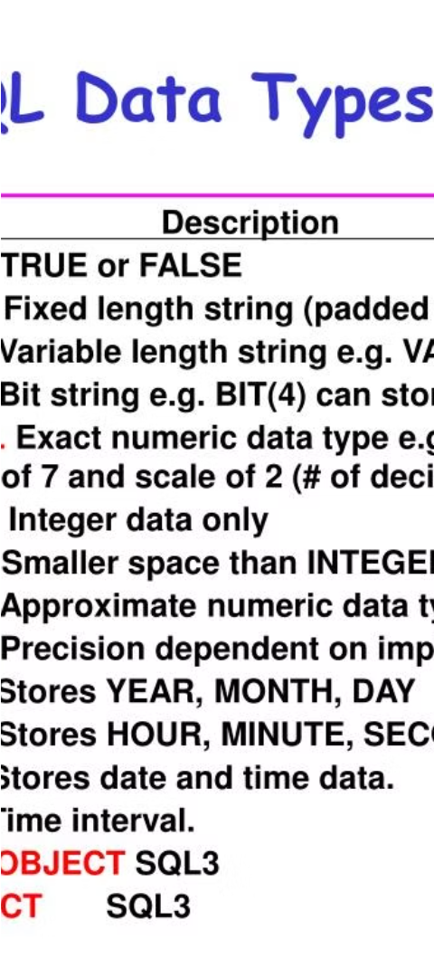
SQL Data Types and Operators
1
Numeric Data Types
2
Text Data Types
SQL offers a range of numeric data types, including integers, floating-point numbers, and decimal values, to accommodate different types of numerical data.
SQL provides text-based data types, such as CHAR, VARCHAR, and TEXT, to store and manipulate character-based information, including names, addresses, and descriptions.
3
Logical Operators
SQL's logical operators, like AND, OR, and NOT, allow you to combine multiple conditions in your queries, enabling more complex and precise data filtering.

Slide 4
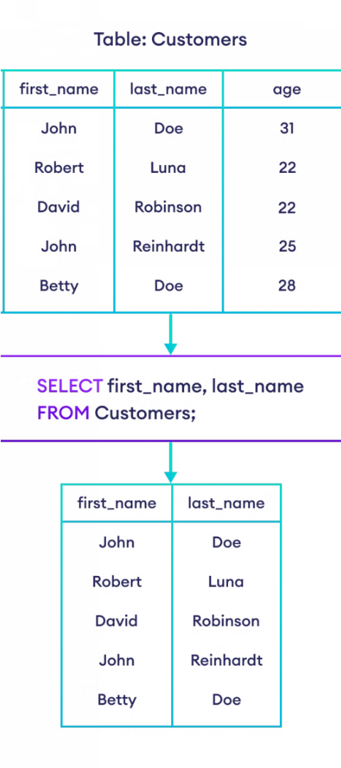
SQL Statements: SELECT, FROM, WHERE
1
SELECT
The SELECT statement is used to retrieve data from a database, allowing you to specify the columns you want to include in the result set.
2
FROM
The FROM clause is used to specify the table(s) from which the data should be retrieved, forming the foundation of your SQL query.
3
WHERE
The WHERE clause is used to filter the data based on one or more conditions, enabling you to focus on the specific information you need.

Slide 5
SQL Joins and Relationships
Inner Join
Outer Joins
The INNER JOIN clause is used to combine rows from two or more tables based on a related column between them, returning only the matching records.
SQL offers LEFT, RIGHT, and FULL OUTER JOIN options to include all records from one or both tables, even if there are no matching rows.
Self-Joins
Relationship Types
A self-join is a special type of join where a table is joined with itself, allowing you to compare data within the same table.
SQL supports one-to-one, one-to-many, and many-to-many relationships between tables, which are crucial for modeling real-world data structures.

Slide 6




SQL Aggregation and Grouping
SUM
AVG
MAX
MIN
Calculates the total of a numeric column.
Calculates the average value of a numeric column.
Returns the maximum value in a numeric column.
Returns the minimum value in a numeric column.

Slide 7
SQL Best Practices and Optimization
Use Meaningful Names
Clearly name tables, columns, and aliases to improve code readability and maintainability.
Minimize Data Returned
Only select the columns you need, and use filters and subqueries to limit the amount of data retrieved.
Index Strategically
Create indexes on columns used in JOIN, WHERE, and ORDER BY clauses to speed up query execution.
Monitor and Tune
Regularly review query performance and make adjustments to improve efficiency, especially for critical or frequently run queries.

Slide 8
THANK YOU

